Slide 1







Industrial Internship -
Monitoring of Database Functionality Using Structured Query Language(SQL)
DETAILS
PRESENTED BY | Saswat Seth
REGN. NO. | 20010352
ROLL NO. | CAM20023
GROUP | 5
C.V. Raman Global University

Slide 2

Outlines
Introduction | 3
Training Sessions | 4
Technical Focus | 5-6
Project Overview | 7-8
Internship Certificate | 9
Conclusion - Achievements | 10

Slide 3

Introduction
Introduction
About the University:
Overview of Central University of Odisha(CUO)
Establishment under Central Universities Act, 2009.
Formerly known as Central University of Odisha.
Location: Sunabeda Town, Koraput District, Odisha, India.
Territorial Jurisdiction : Entire state of Odisha.
Campus Location
Village Chikapar and Chakarliput, Sunabeda NAC (Urban area).
Proximity to Hindustan Aeronautics Limited (HAL), Sunabeda.
In the picture: Central university of Odisha’s logo
Academic Structure
School of Basic Sciences & Information Sciences
Departments:
Department of Computer Science (DCS)
Department of Mathematics (DM)

Slide 4
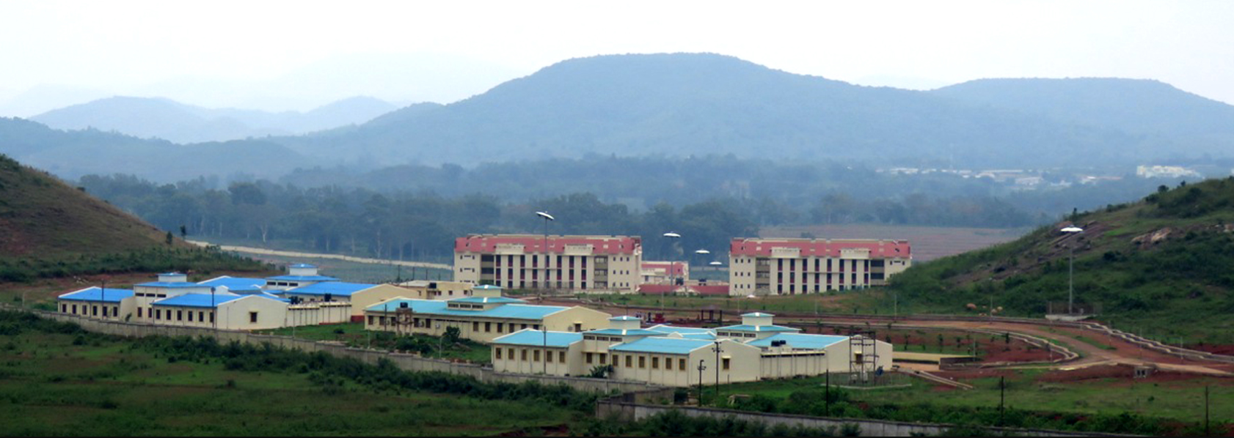
Training Sessions
Duration of Internship
The internship spanned a concise period of 15 days.
Timeline of Internship Period
Commencement Date: 8/5/2023
Conclusion Date: 22/5/2023
Weekly Training Information
Breakdown of Weekly Training Sessions
Morning Session: 9:30 am - 1:30 pm
Afternoon Session: 2:30 pm - 4:30 pm
Sundays
Dedicated to Revision and Practice Questions.
In the picture: Central university of Odisha

Slide 5
Technical Focus
Internship Training Topics/Technologies
Overview of Topics Covered
1st Week
Monday
Introduction to Internship Project
Introduction to SQL
Tuesday
MySQL Introduction
MySQL Queries
Wednesday
MySQL Advanced Queries
Introduction to PostgreSQL
Thursday
PostgreSQL Basics
PostgreSQL Advanced Queries
Friday
Comparative Analysis
Saturday
Recap and Review
2nd Week
Monday
Music Store Database Assessment
Database Schema Review
Data Types and Constraints Assessment
Wednesday
Query Performance Analysis
Optimization Techniques
Thursday
Current Indexing Analysis
Strategies for Optimal Indexing

Slide 6
Technical Focus
Overview of Topics Covered(contd.):
Friday
Data Quality Assessment
Final Database Assessment
Saturday
Documentation
15th Day
Monday
Finalization, Recommendations, and Assessment
Internship Experience
Engaging Exploration:
Explored the intricacies of a music store database, making the project intellectually stimulating.
Practical Application:
Applied theoretical knowledge to real-world scenarios in MySQL, PostgreSQL, and SQL.
Dynamic Learning:
Embraced a holistic learning approach, finding the nuances of database systems intriguing.

Slide 7
Project Overview
Scope and Objectives of the Project
MySQL, PostgreSQL, SQL Mastery:
Proficiency gained through hands-on experience.
Applied MySQL and PostgreSQL for real-world projects.
Leveraged SQL language for robust database interactions
Adaptability Across Platforms:
Seamlessly transitioned between MySQL and PostgreSQL.
Executed efficient queries for diverse data handling.
Holistic Learning Approach:
Explored nuances and differences in each database system.
Enhanced problem-solving skills across MySQL, PostgreSQL, and SQL.
Project Overview
Comprehensive Assessment of Music Store Database.
Exploration of Core Database Structures.

Slide 8
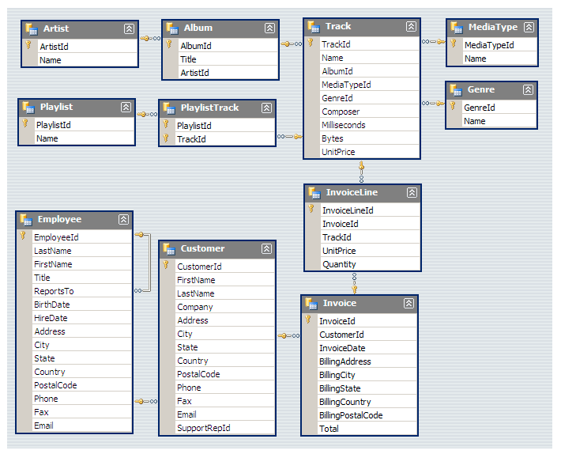
Project Overview
In-Depth Analysis of Schemas, Data Types, and Constraints.
Motivations, Objectives, and Immersive Learning.
Database Schema Analysis
Focus: In-Depth Review of Current Schema.
Examination of Tables, Relationships, and Constraints.
Laying the Groundwork for Subsequent Assessments.
Gained Insights into Database Intricacies.
Adaptability Across Platforms
Executing Efficient Queries for Diverse Data Handling.
Exploring Nuances and Differences in Each Database System.
Enhanced Problem-Solving Skills Across MySQL, PostgreSQL, and SQL.
In the picture: Music store database schema

Slide 9
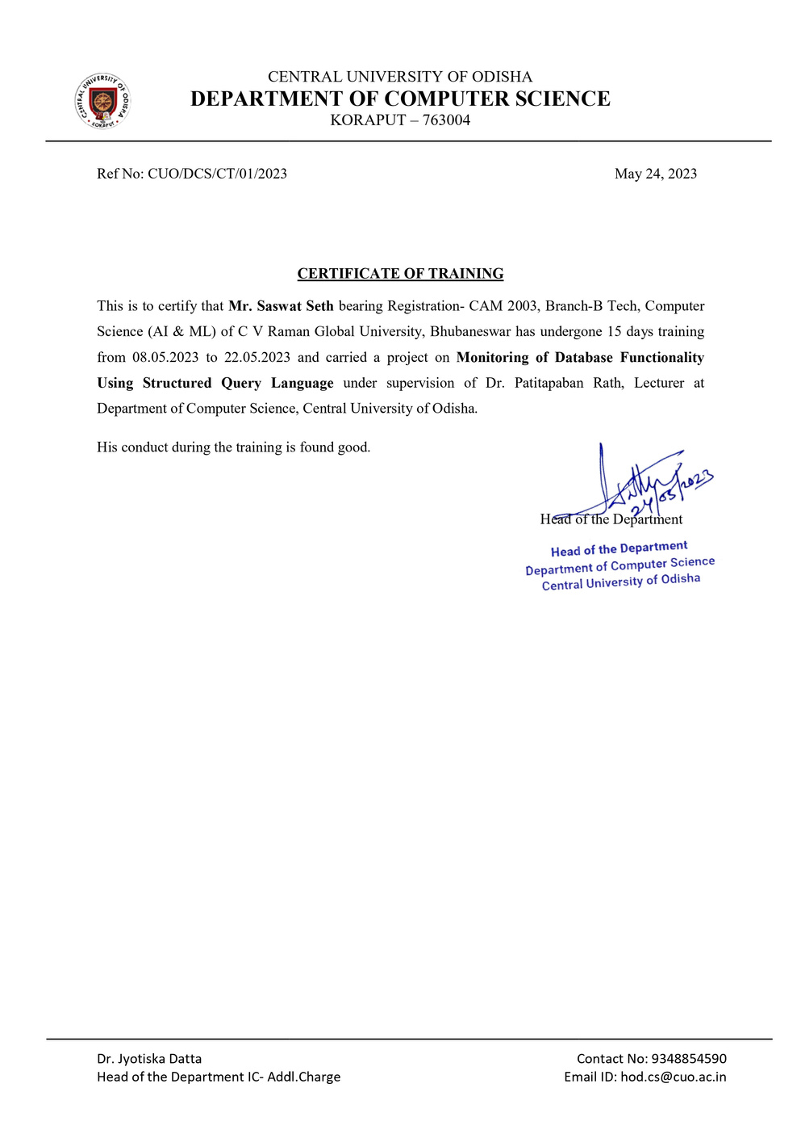
Internship Certificate
Internship Certificate Details
Issued by the Department of Computer Science, Central University of Odisha.
Recipient: Mr. Saswat Seth, B.Tech Student of C V Raman Global University, Bhubaneswar.
Training Duration: 15 Days (08.05.2023 to 22.05.2023)
Project: Monitoring of Database Functionality Using Structured Query Language.
Supervisor: Dr. Patitapaban Rath, Lecturer at the Department of Computer Science.
Conduct and Signature
Mr. Seth's Conduct During Training: Good.
Signed by Dr. Jyotiska Datta, Head of the Department of Computer Science.
Date of Certificate: 24.05.2023

Slide 10
Conclusion - Achievements
Conclusion - Reflections on the Internship Journey
A transformative 15-day journey, delving into the intricate realm of database management and analysis.
Dissected the nuances of real-world database challenges, gaining insights that transcend theoretical knowledge.
Emerged with a strengthened skill set, poised to contribute effectively in dynamic database-driven environments.
Reflecting on my internship journey, acknowledging key learning milestones and achievements I -(contd.)
Practical Proficiency: Gained hands-on expertise in database management systems—MySQL, PostgreSQL, and SQL.
Problem-Solving Skills: Enhanced analytical and problem-solving skills through comprehensive database analysis.
Successful Project Completion: Accomplished the "Monitoring of Database Functionality Using Structured Query Language" project with a thorough understanding of database schemas, data types, and constraints.

